Slide 1

Autoverse Tech
INFOTAINMENT VALIDATION ENGINEER
GROUP-2

Slide 2

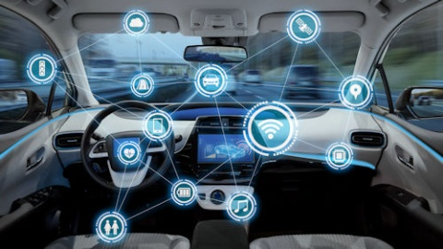
About Us
Team Lead: Shuaib
My Team: Foysal,Arafath,Rokib,Zahirul,Imran,Alam,Shahida

Slide 3

Our Domains
AM
Apple Car Play
SWC ( Steering wheel Control)
I heart radio
Spotify
VR (Voice Recognition)
HVAC (Heating, Ventilation & Air-condition )
Autoverse

Slide 4

Domain VR (Voice Recognition) Presented By-Shuaib
What is VR?
Voice recognition (VR) is a hands-free way to control various parts of a vehicle.

Slide 5
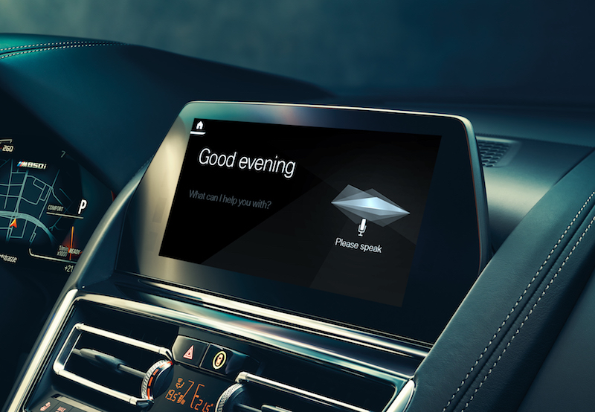
Section:1
History of VR
Cars are increasingly becoming computerized, and that means the automotive industry is rapidly becoming a fast follower in adopting the latest advances in everything. VR is one of the new technology carmakers start using. If we look at the history, the ability to use your voice to control in-car systems isn’t a new idea. Early 1996 Mercedes-Benz’s included VR systems on their W140 S-Class and had the capacity to understand total of 30 words. (source google.com)

Slide 6
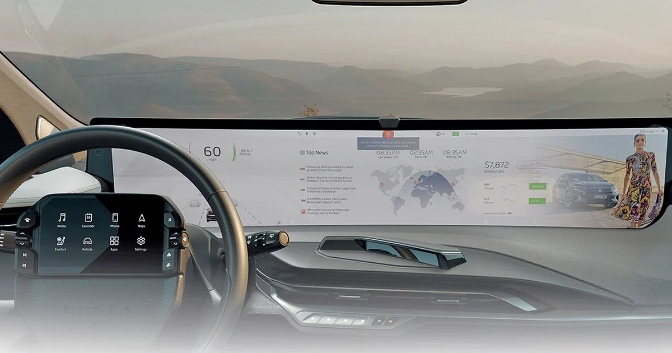
Functionality and integration:
Carmakers have broadly adopted three different approaches to integrating voice recognition systems within their vehicles.
1. Embedded system-This means functionality is built into the car’s internal computer systems, this allows the carmaker to greatly expand the range of interior functions that can be controlled by voice command.
2.Smartphone based voice assistance - Siri or Google Assistant offered on the driver’s smartphone is made available in the car through Apple CarPlay or Android Auto.
3. Steering wheel mounted buttons- The voice assistant can usually be activated via a button on the steering wheel.
Voice Recognition functionality vary by car model and year. Most commonly use function are control by VR is Phone, Radio ,Media, and Navigation.
Overview of the command for each application are below listed .
Phone commands –Make Call followed by a contact name and phone number . Voice mail check etc.
Radio Commands- FM commands are Tune to followed by a FM frequency , AM commands are Tune to followed by a AM frequency.
USB commands –Play song followed by Song name, Artist name, Album name and playlist name.

Slide 7
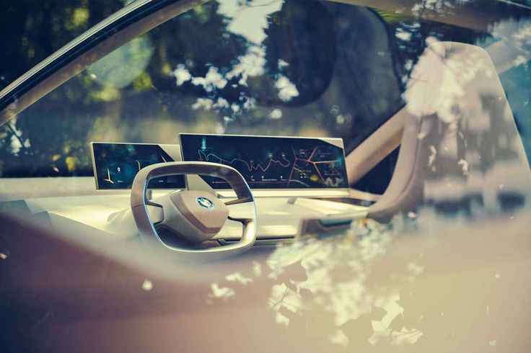
Section 2
How we test VR ?

Slide 8

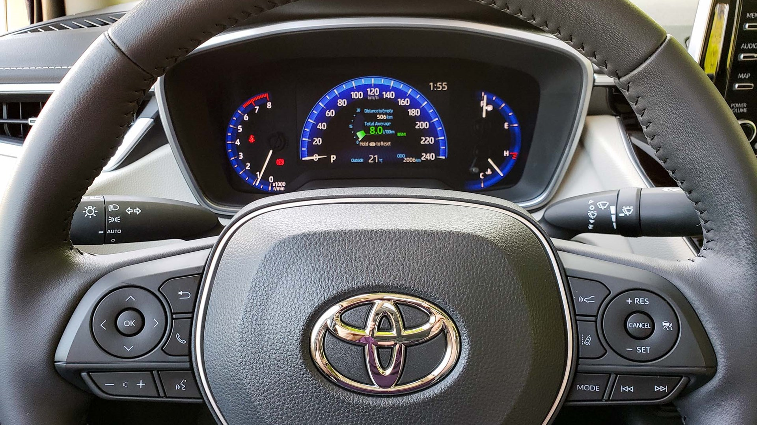
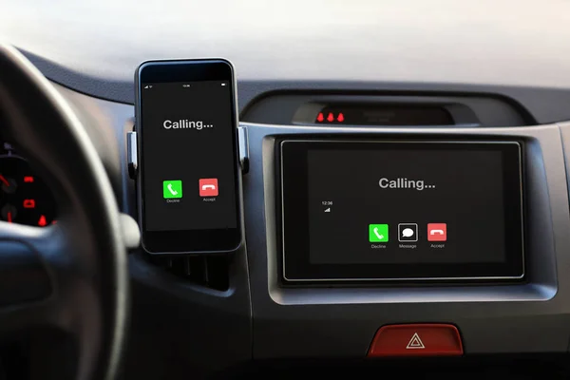
Steering wheel mounted buttons:
Pre-Condition
System On
A connected Phone (via BT)
Description
Verifying user able to make phone call by press and hold the Voice command button on steering wheel.
Test step
Press and hold Voice command button on steering wheel.
Say call “Shuaib”
Observe the screen for calling
Expected result
User should be able to make the call using voice command.
Actual Result & Status
User able to make the call using voice command.
Status : Pass
Observe calling screen
Voice Command button

Slide 9

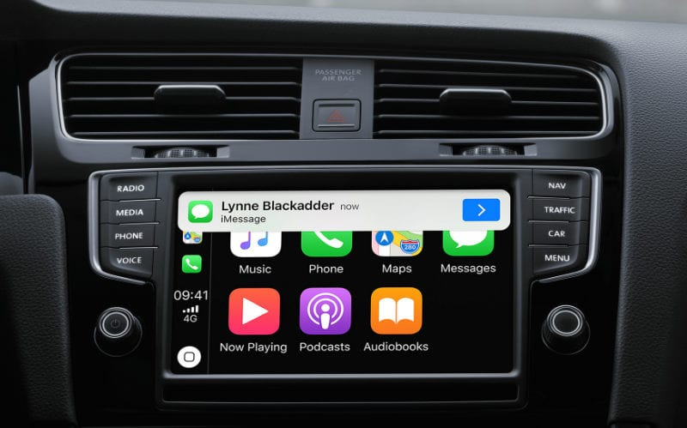
Smartphone based voice assistance
Pre-Condition
System on
An iPhone connected to HMI via lightening cable (13 pro max v-16.0)
Description
Verifying user able to send Message by Saying “hey Siri” voice command and followed by the contact's name (Shuaib) and message .
Test step
Select Apple car play app on HMI
Say Hey Siri
Wait until you hear the beep or response by Siri.
Say “send a text message to Shuaib”
Wait until you here response from Siri by saying “what you want to say to Shuaib”
Say Hello Shuaib.
Wait for Siri to confirm if you want to send message by saying “do you want to change message or send message .
Say “message send”
Observe a message has been sent to Shuaib.
Expected Result
User should be able to send message by using hey Siri voice command followed by contact name (Shuaib) and message .
User should be able to observe a message sent to the recipient.
Actual result & status
User able to send message to the recipient .
Status: Pass

Slide 10

Voice Intelligent Assistant on Toyota (Embedded system)
Pre-Condition
System on
Description
Verifying user able to turn on radio by saying “hi Toyota turn on the radio”
Verifying user able to observe metadata screen.
Test step
Say Hi Toyota turn on the radio
Observe Radio metadata on HMI screen.
Expected Result
User should be able to turn on radio by saying “hi Toyota turn on the radio” & observe metadata on HMI screen.
Actual Result & status
User not able to turning radio on by saying “hi Toyota turn on the radio” & no metadata screen is available.
Status: Failed. Screen frozen with a message saying, “turning on the radio”.
Bug ID: 012

Slide 11

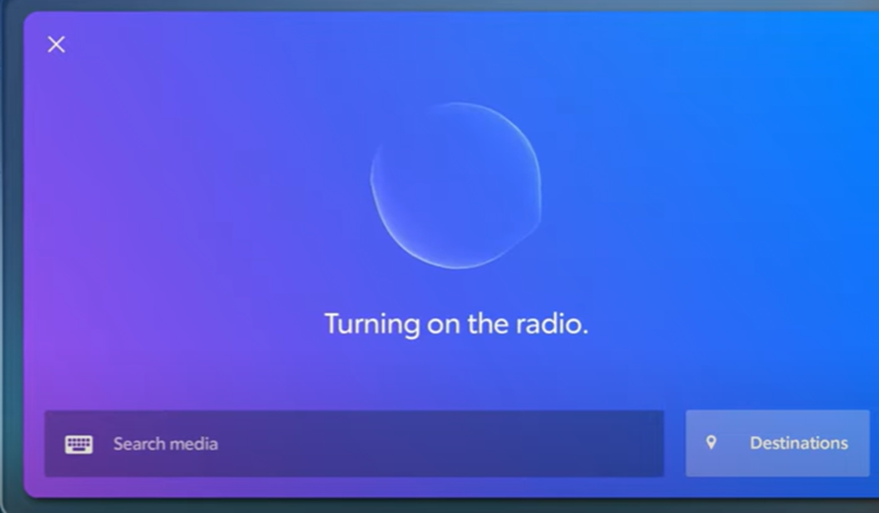
Bug report 012
Summary: Screen frozen no metadata available .
Priority : P1
Status: New
Description: HMI wasn’t responding on voice Command .Screen frozen before turning on the radio . Follow below step in order to reproduce the bug –
Pre-condition- System on
Test description- Verifying user able to turn on the radio by saying “hi Toyota turn on the radio” & user able to observe metadata screen.
Test step- Say Hi Toyota turn on the radio & Observe Radio metadata on HMI screen.
Expected result- User should be able to turn on radio by saying “hi Toyota turn on the radio” & observe metadata screen on HMI.
Actual result: Screen frozen .
Reproducible rate: 80%
Environment: Vehicle
Evidence : Attached
Build: 6.5.21
Model: 2022 Toyota tundra premium
Reporter –Shuaib, Assignee- Developer X.

Slide 12
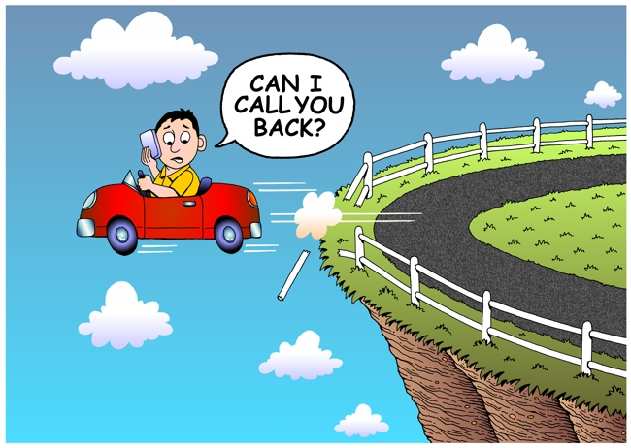

Section : 3 Why are they important ?
The importance of the voice recognition (VR) testing is to make sure it meets all customer requirement and reasonable bug and defect free.
From a user perspective, use of the speech recognition tools facilitates easy multitasking while driving .Its helps driver not to distract on the road and stay connected with friends and family when necessary.
Now you know
why VR is so
important

Slide 13

THANK YOU

